Slide 3
Architecture and zoning Parking space issues
Design of the parking spot
-> The current infrastructure needs to adapt (need of extra space on the front and the sides of a parking spot, electric infrastrucure on parking areas)
Possibility to have a parking spot at home (high density cities) or at work
20 million people cities ?

Slide 4
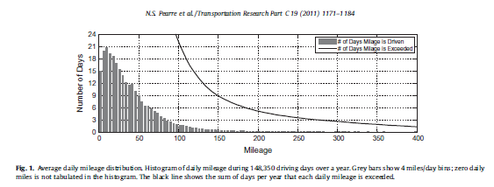
Architecture and zoning The range anxiety effect
95% of the days, mileage does not exceed 100 miles
-> enough for EV
But fear of being out of battery very strong in the minds

Slide 5
Regulations
Creation:
Companies (ChargePoint, CHAdeMO) intrinsecaly create rules and standards with their products
E.g. Plug in system, standardisation of the models
Adaptations:
Governments and organizations (International Electrotechnical Commission, European Environment Grenelle in the EU, …) try to adapt the already existing set of rules to the new technology.

